Slide 1
Presentation
Final Year Project

Slide 2
Textile Auxiliaries

Slide 3
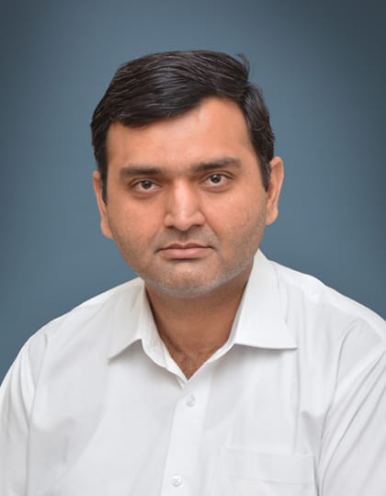
Project Supervisor
Prof. Saad Razzaq(HOD)
Department CS&IT

Slide 4
TEAM

Slide 5
Team Member
Professional team that can solve just anything you need
Muhammad Abuzar
Danish Tahir
Haseeb Anwar
17-uglc-420
17-uglc-445.
BCSF18E043

Slide 6
Abstract
We are going to make the textile work in this project open-source. We are creating an online web integrated and mobile application based system for Textile Industries. The Textile Auxiliaries is a platform for buying and selling services and goods such as yarn, cloth, and clothing. In this seller provides all information about our services. And the buyer can also request services. This is beneficial for both parties as compared to the conventional system because it saves time and physical efforts like go and check the services of different industries.

Slide 7
Project Overview
Many textile sites are contributing to this but no site provides everything from raw materials to finished products. For example, in OLX[1], the only ready-made cloth is available. We can't make our designs and colors. Similarly, there is another website called “Wal-Mart [2]” in which they also give the option to select the colors of the fabric, but even here we cannot design the fabric on our own. We can order by selecting one of the designs that they already have.

Slide 8
Main Objectives
Main Objectives are the system is a reliable secure and efficient, the system is available24/7, easy to use and friendly interface and this works with internet connectivity.
In this project, we provide:
Business-to-consumer (B2C) and business-to-business (B2B) sales services via a web portal and mobile applications as well as electronic payment services and real-time tracking of orders.
It owns and operates a diverse portfolio of companies in numerous business sectors.
We provide the web portal and mobile application to the sellers where they create their account first. Were
Seller provides its goods or services details.
The buyer uploads their requests or searches for the services which they need.
Both can receive or make orders, and also can track their orders.
The buyer can post their request by their requirements.
.

Slide 9
Project Purpose
We are adding to them that we can produce goods in custom design, colors and quality. Like they can make their goods by sending their design to the seller. There are some things we are adding to it, such as the seller may request the buyer that we have to produce goods in such a design, colors and quality which the buyer provides. And also, the seller can upload his services to see what he is providing. This is beneficial for both parties as compared to the conventional system because it saves time and physical efforts like go and check the services of different industries. There are some advance and security features like privacy, tacking and monitoring of orders, analytics of seller, ratings, chatbots etc.

Slide 10
Project Scope
That is why we are going to make the textile work in this project open-source. ‏We are creating an online web integrated and mobile application based system for Textile Industries. The Textile Auxiliaries is a platform for buying and selling services and goods such as yarn, cloth, and clothing. In this seller provides all information about our services. And the buyer can also request services. This is beneficial for both parties as compared to the conventional system because it saves time and physical efforts like go and check the services of different industries

Slide 11
Functional Requirements

Slide 12
Functional Requirements
01
Admin
Login:
Login for admin with admin privileges.
Verify the Industries:
Admin has the right to verify the Industries.
Reject the Industries:
Admin has the right to reject the Industries.
Manage Industries:
Admin has the right to manage the Industries.
Manage End Users:
Admin has the right to manage the End Users.
Manage Industries Information.
For Reviews and ratings:
Trustpilot tool will use for reviews and rating system.

Slide 13
Functional Requirements
02
Owners
Create Account on the Web-Portal.
Registration:
Register from the system.
Credentials for registration
Login:
User name & password
Create ads
Provides the details of products or services. Like, Name, Pricing, Category, Quality, Colors, Quantity,
Add, Edit & Delete Ads:
Owner can Create, Edit and Delete ads of their goods and service.
Send offers to Buyers Requests.
Main Dashboard to manage their orders.

Slide 14
Functional Requirements
03
End-Users
Download the application or Go to Web-Portal:
Application should be cost-free:
Everyone can download on Devices.
Registration: Register from the system
Credentials for registration
Profile page:
Where show orders, requests, personal information etc.
Search:
Users can search what they need.
Filters:
Users can filter Ads by Pricing, categories, industries, and Location.
Search Result:
If no search result found then show relevant Ads.
Post Requests:
Users can post requests by providing the details. Like, Quantity, Quality, Pricing, Time Duration, Category.

Slide 15
Assumptions and Dependencies
Our system made multiple assumption and dependencies with users. Some of the assumptions are as follow:
First of all, customer/branch owner must have an internet connection.
Secondly, customer/ branch owner must have an android mobile or a system where he has an access of our application.
Another assumption is, customer/ branch owner must have a version of 4 GB android or above.
It is also assumed that our app is compatible with user’s hardware.
Users must have enough space to run website in their system.

Slide 16
Risks and Volatile Areas
The design structure of our system is very flexible. We can easily add a new module in the existing system. The risks which can occur in the system are following
Fake account can cause of misguidance.
Any software or hardware failure may occur.
Any intruders in terms of hacker can affects our system.
Database may crash.
Server can be down.

Slide 17
THANK YOU!

